Slide 1
Platform API

Slide 2
Objectives
API platform
Using Geolocation API
Accessing the user’s image and camera

Slide 3
What is an API platform?

Slide 4
API platform
An API platform is a software system with integrated tools and processes that allow teams to effectively build, manage, publish, and consume APIs.
An API platform helps API producers manage the entire API lifecycle - from design to production - while engaging directly with API consumers.

Slide 5
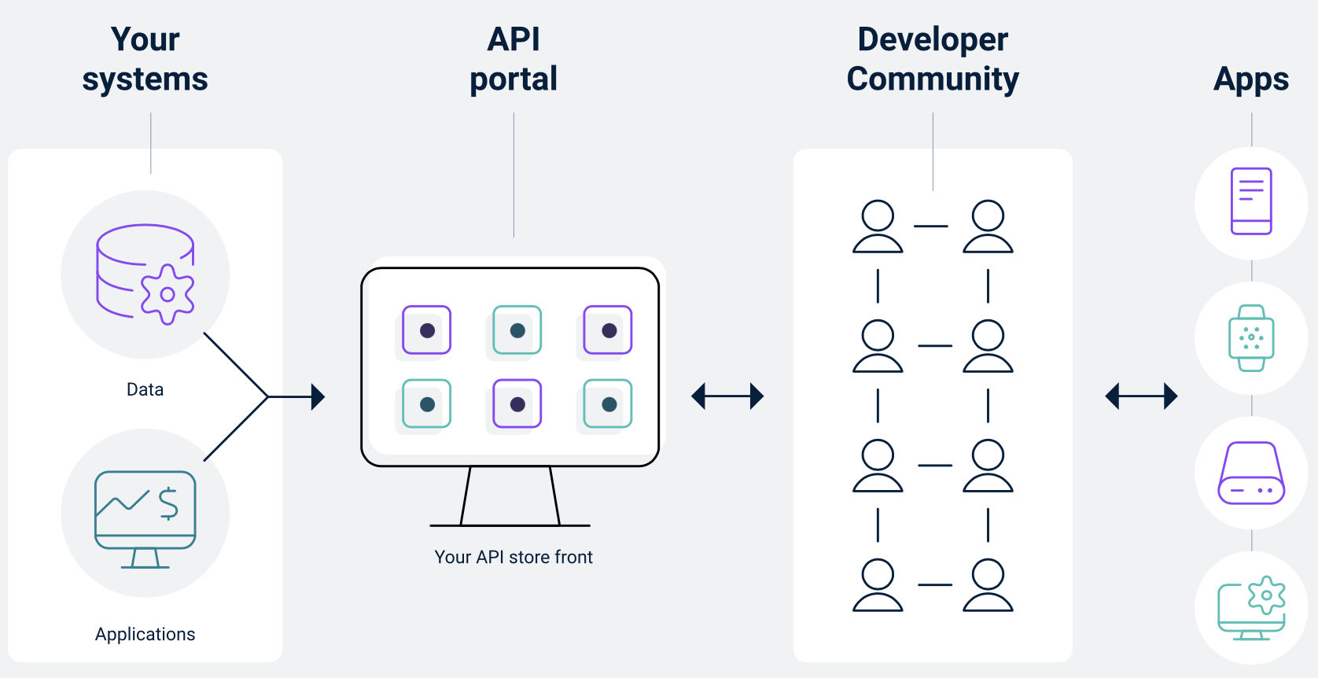
API platform
API platforms complement and enhance existing workflows through integrations with source code management tools, CI/CD pipelines, cloud infrastructure, and APM solutions.
Enable leaders to create and implement API governance and security strategies that foster collaboration, promote consistency, and reduce risk.

Slide 6
Geolocation API

Slide 7
What Is the Geolocation API?
The Geolocation API provides access to geographical location data associated with a user's device. This can be determined using GPS, WIFI, IP Geolocation and so on.
To protect the user's privacy, it requests permission to locate the device. If the user grants permission, you will gain access to location data such as latitude, longitude, altitude, and speed. You'll also get the accuracy of the acquired location data and the approximate time when the position was acquired.

Slide 8
A few uses for geolocation:
Show user's position on a map
Get up-to-date local information
Show local Points-of-interest (POI) near the user
Enable Turn-by-turn navigation (GPS)
Track a fleet or delivery vehicle
Tag photographs with a location

Slide 9
Demo
Using Geolocation API to show user's position on a map

Slide 10
React Native Maps
Maps are an integral part of a lot of mobile apps nowadays. They are used for everything from finding directions to tracking one’s location when jogging.
In this demo, we will learn how to integrate Google Maps into a React Native app.
Using library: react-native-maps

Slide 11
Basic Setup
using Expo CLI to create a React Native app. It is much easier to use than React Native CLI and is very efficient for a small map demonstration like this demo.
If we want finer control in our production project, we need to go with React Native CLI. As per expo documentation, we need to install Expo CLI globally using the command below.

Slide 12
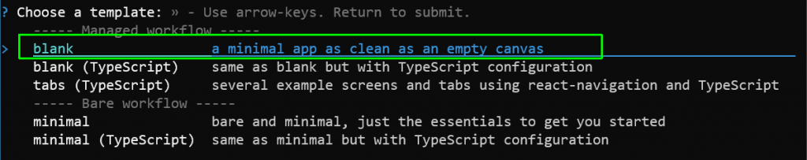
Basic Setup
Now, we will create a new project for our app using the command below.
expo init react-native-gmapsExpo will ask us to choose a template, and we will choose the option to create a minimal app.

Slide 13
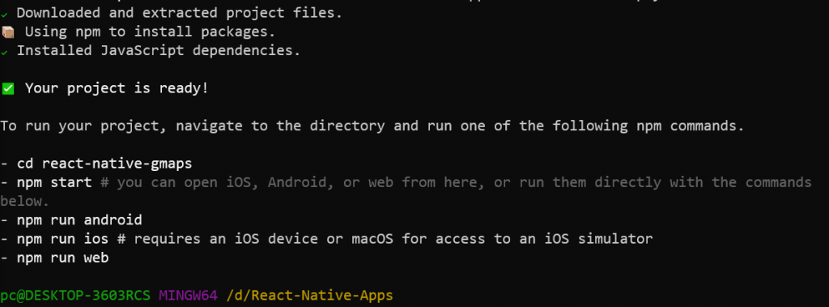
Basic Setup
It will take about two to three minutes to create a React Native app, but it depends on the system configurations. If everything is successful, we will see the screen below.

Slide 14
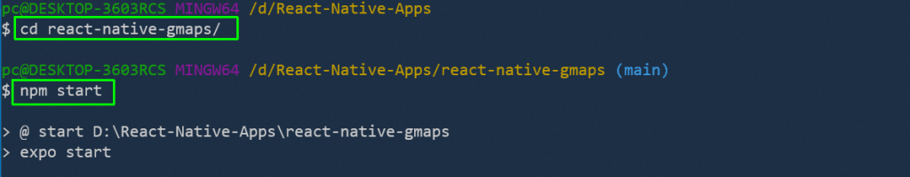
Getting Started
We will now start with our project and follow the instructions above. We need to change to the directory first with the cd command and then start the project with the npm start command.

Slide 15
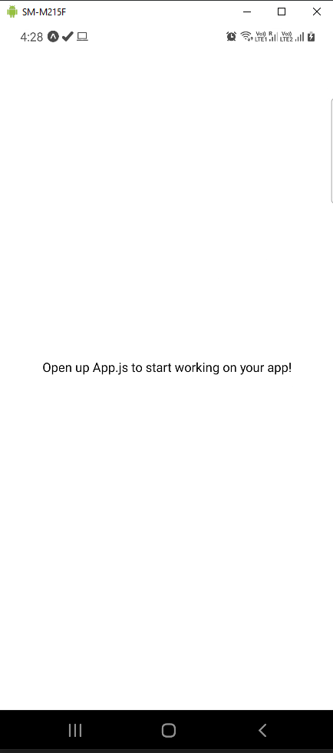
Getting Started
It will open the app on your mobile phone and show the start-up text of a React Native Expo app.

Slide 16
Installation
We will be installing react-native-maps by running the command below from our project folder.
References:
https://github.com/react-native-maps/react-native-maps

Slide 17
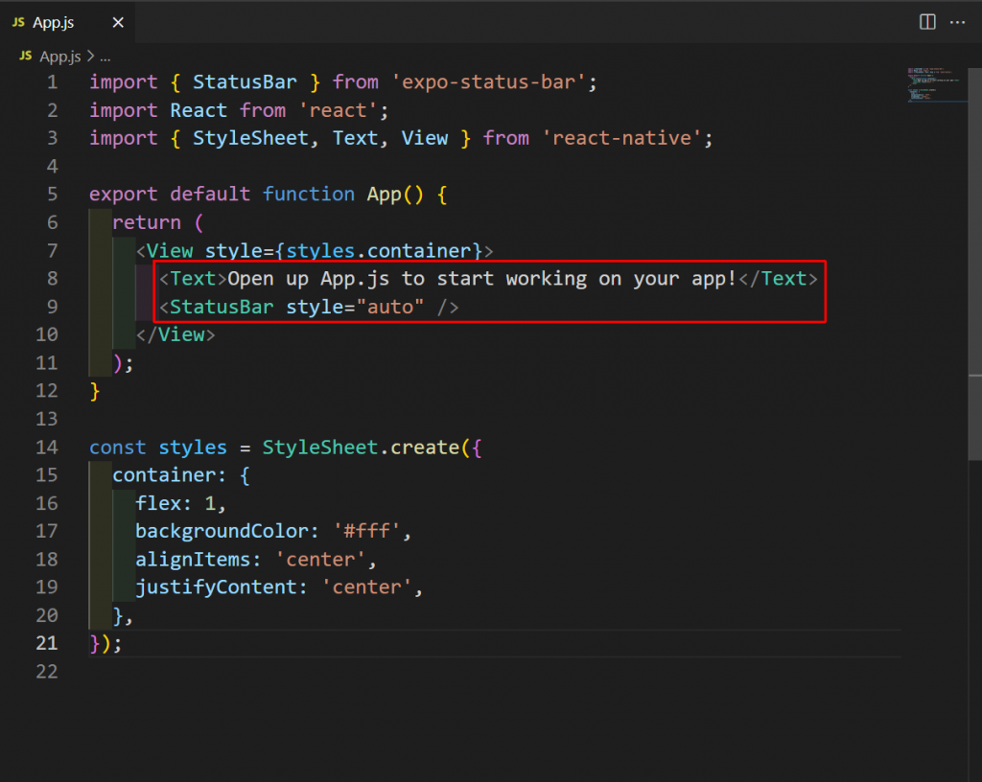
Basic Usage
The starting point of a React Native app is App.js, and for our simple app, we will update it only. Open the App.js file and remove the lines below in it.

Slide 18
Basic Usage
Now we will import MapView, which is used to display the map, in our project. The four props descriptions are described below:
style | To give any specific style to the map. Here, we are using StyleSheet.absoluteFillObject, which will make our app launch in full screen mode.
provider | We are giving the provider as Google. If we don’t specify it, it will be given the native map framework (i.e., Apple Maps for iOS and Google Maps for Android).
mapType | We are taking it as hybrid, which is the default standard. The other options are satellite and terrain.
region | We have to give an object containing latitude, longitude, latitudeDelta, and longitudeDelta. Latitude and longitude are the coordinates in which the map will start. The latitudeDelta and longitudeDelta are used for calculating the size of the map.

Slide 19
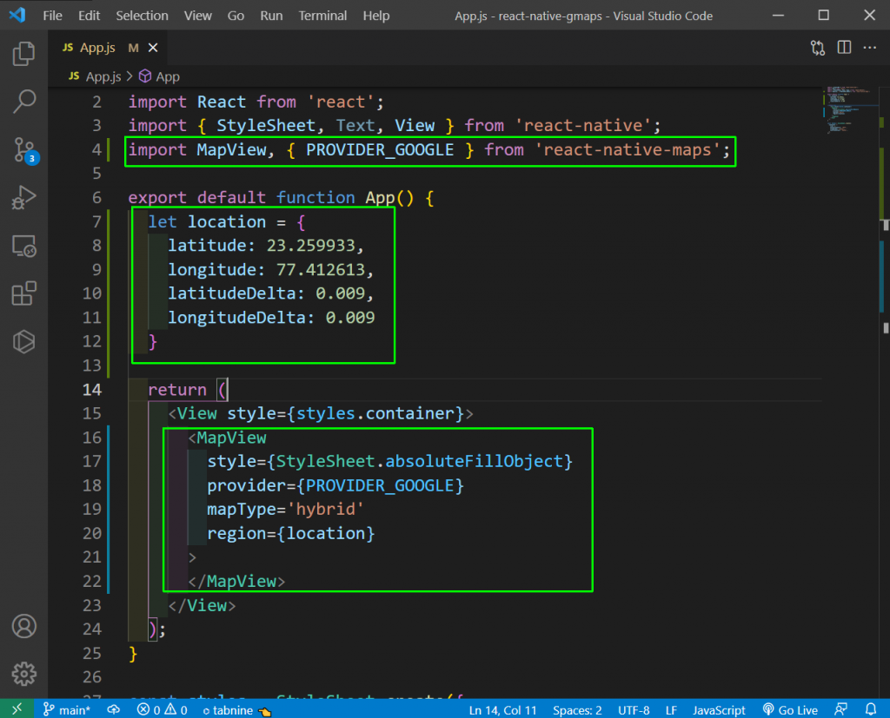
Basic Usage

Slide 20
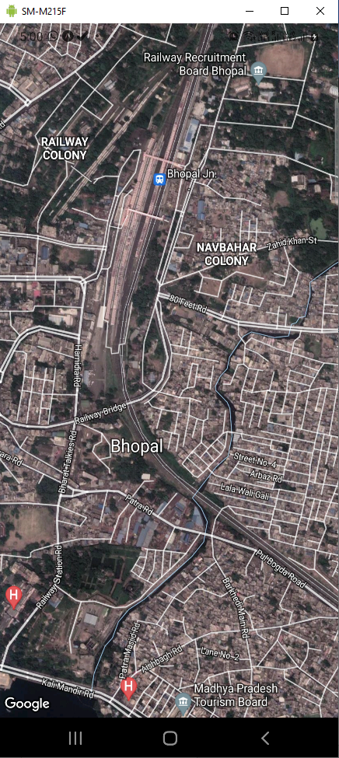
Basic Usage
Now, a beautiful, full-sized Google Map will be shown in our app.

Slide 21
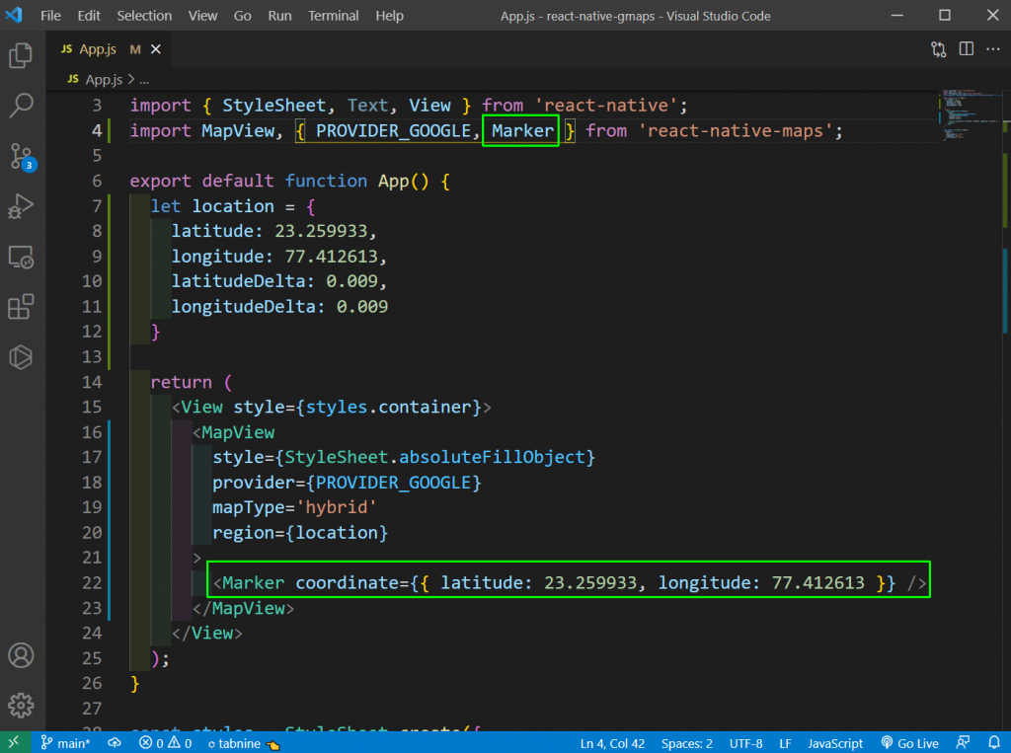
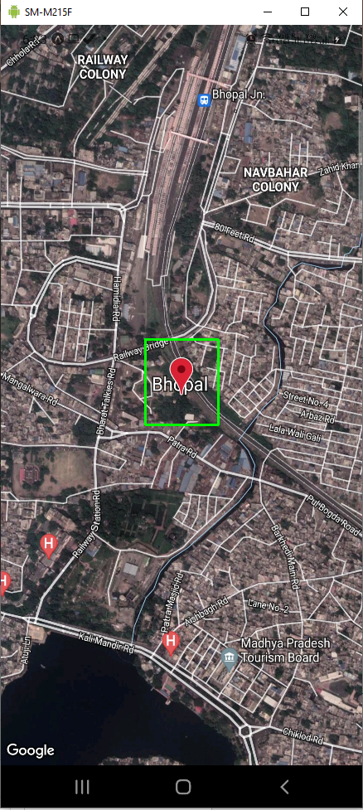
Marker for Current Location

Slide 22
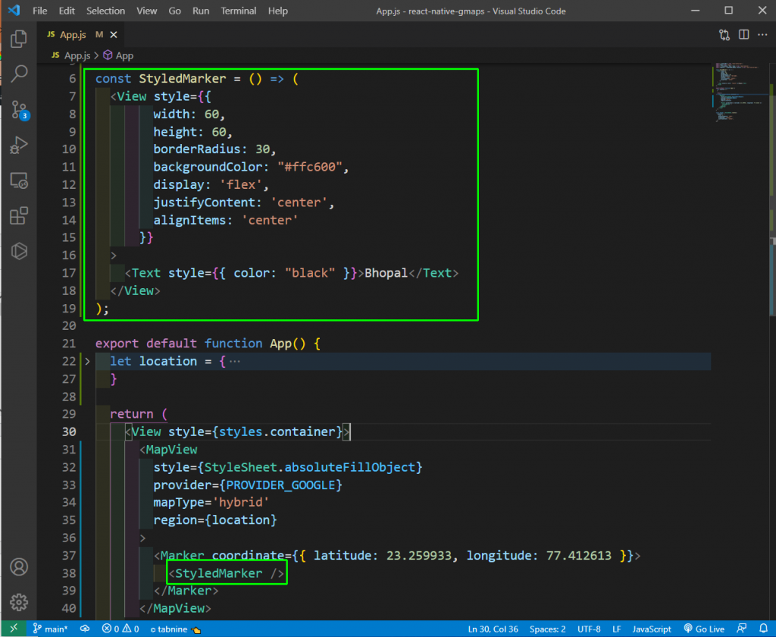
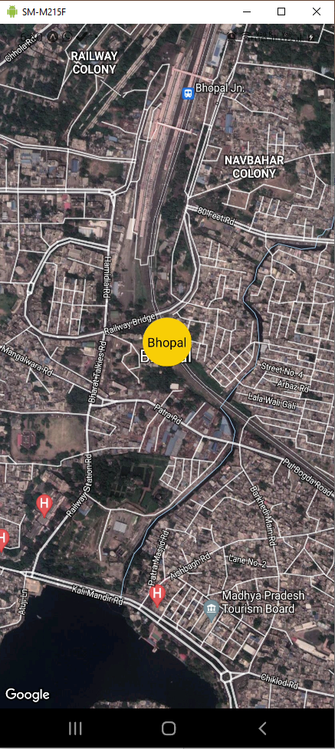
Customizing the Marker

Slide 23
Accessing the user’s image and camera

Slide 24
Create a New React Native App
Run following command to install react-native-cli on your device.
Run the below command to install a fresh new React Native app from scratch.
Enter inside the app directory.

Slide 25
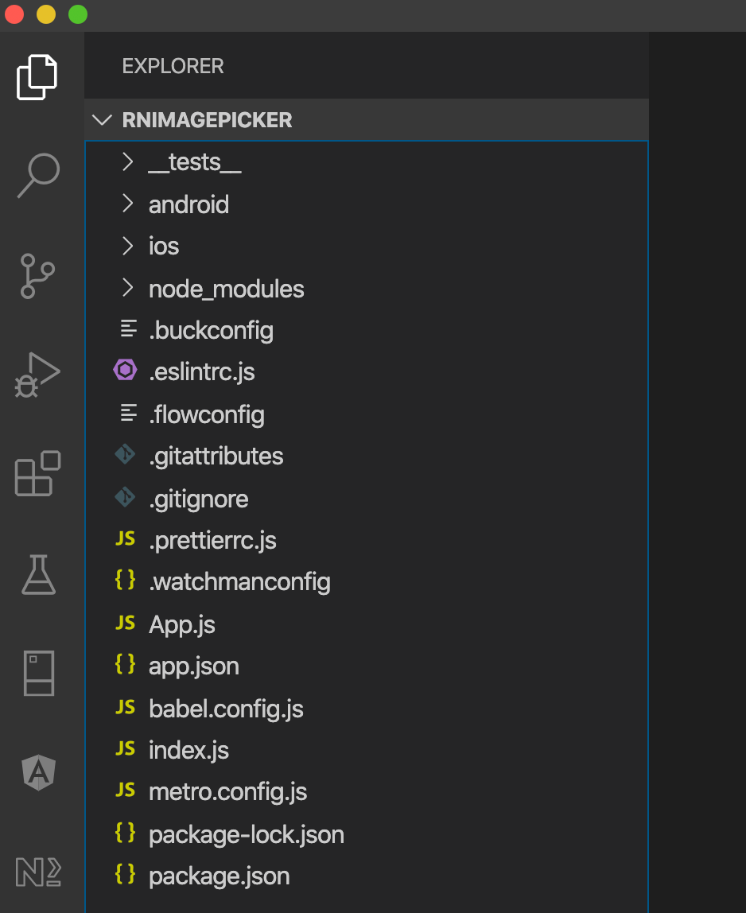
Project structure

Slide 26
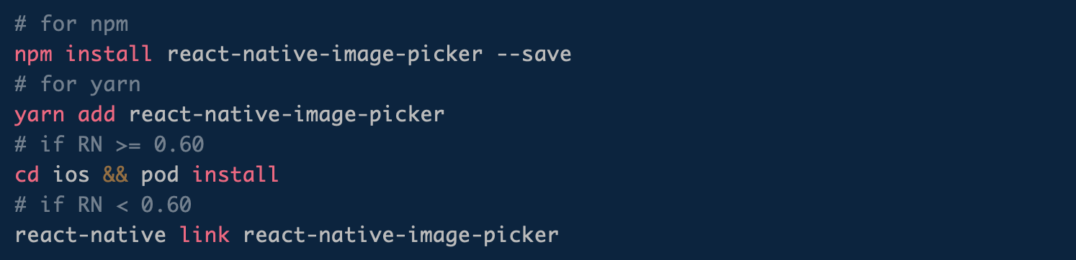
Configure React Native Image Picker
In this step, we will install react-native-image-picker dependency in the React Native app.

Slide 27
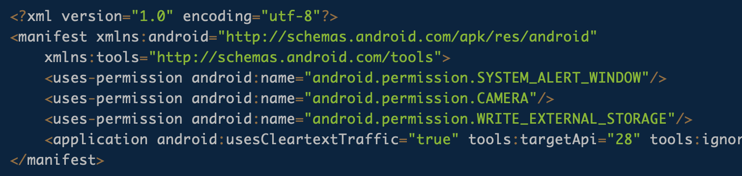
Adding Permission for Android to Use Camera & Access Storage
Go to React Native Project > android > app > src > debug > AndroidManifest.xml file and include the given below permissions.

Slide 28
Using React Native Image Picker in React Native App
The React Native Image Picker plugin offers plenty of options to manage the ImagePicker component.
Title Cancel Button Title Take Photo Button
Custom Buttons Tint Color Camera Type
Media Type Max Width Max
Height Quality Video Quality
Duration Limit Rotation Allows Editing
No Data Storage Options PermissionDenied
Choose From Library Button Title
Choose Which Library Title

Slide 29
Using React Native Image Picker in React Native App
First, we have to import the ImagePicker package at the top of the React Native template.

Slide 30
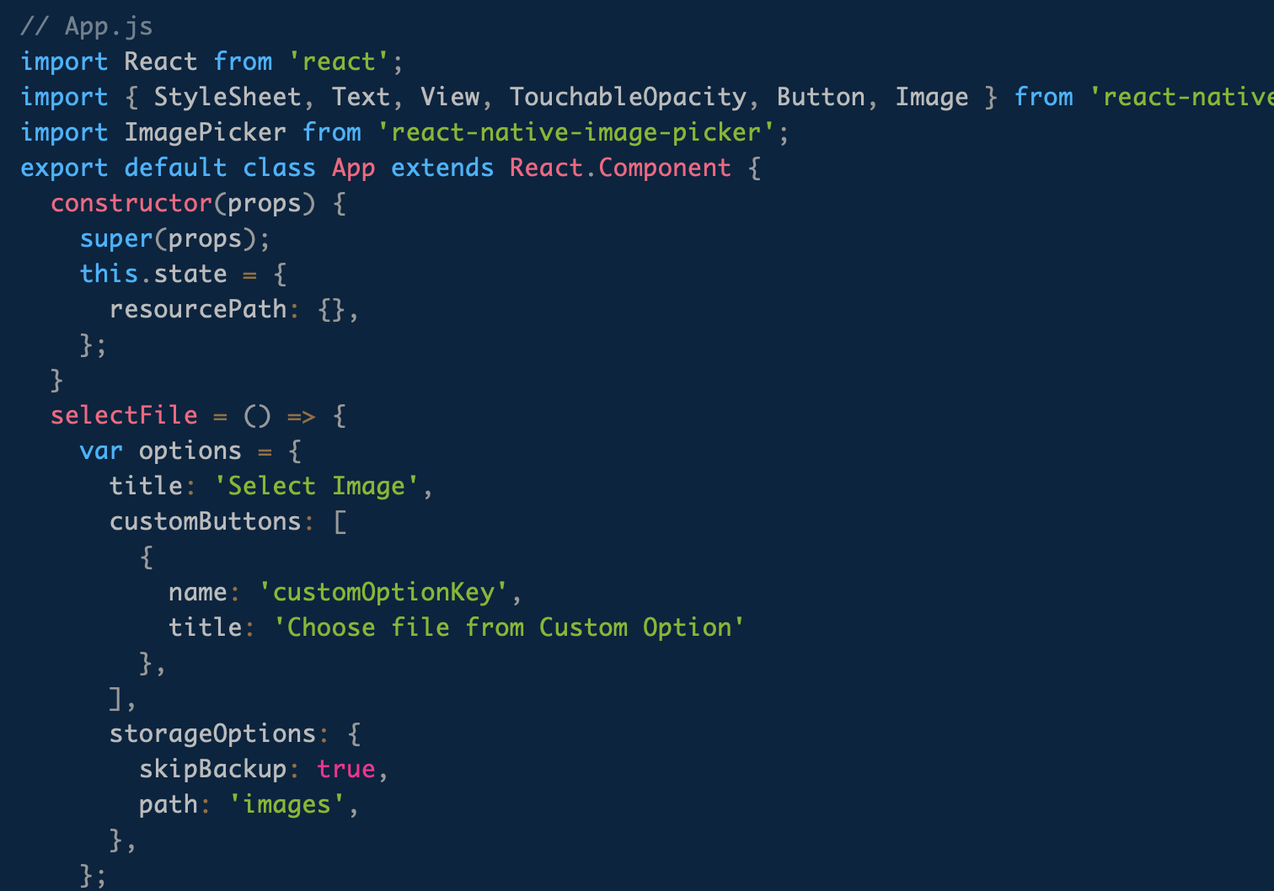
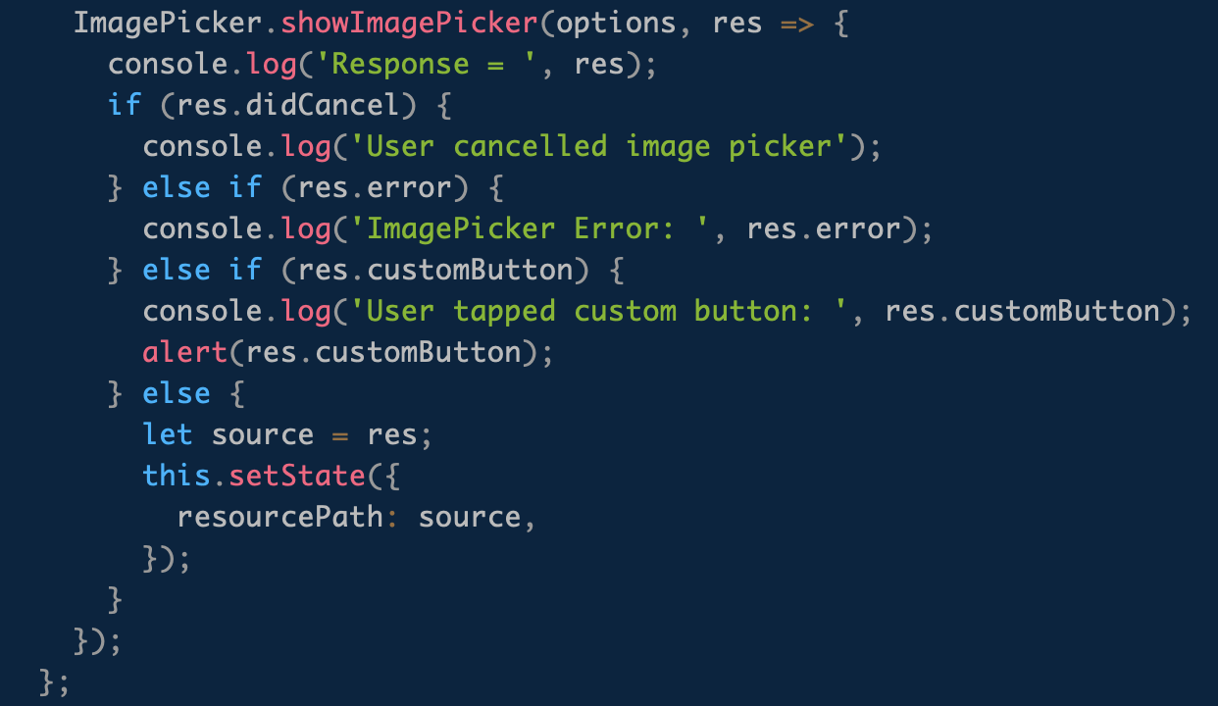
Using React Native Image Picker in React Native App
Replace the existing code of App.js file with the following code.

Slide 31
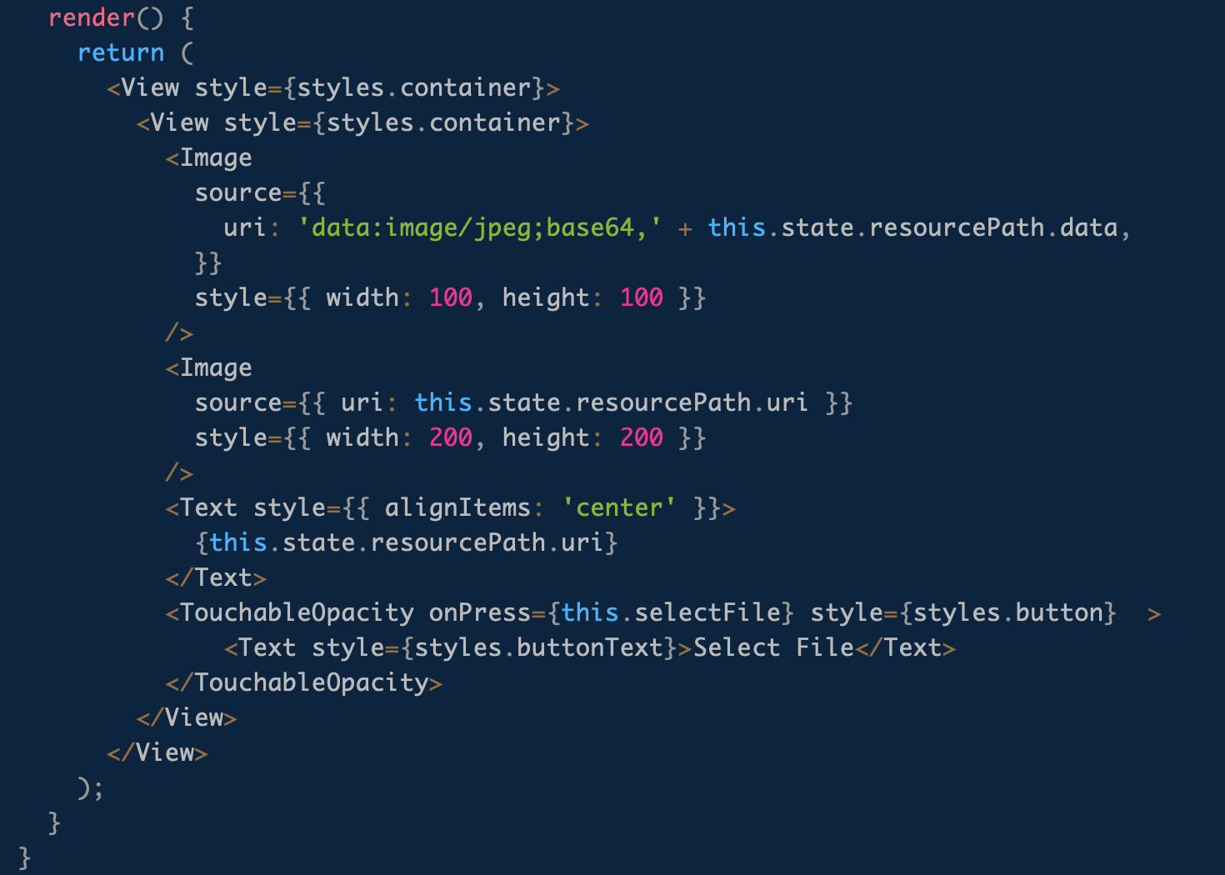
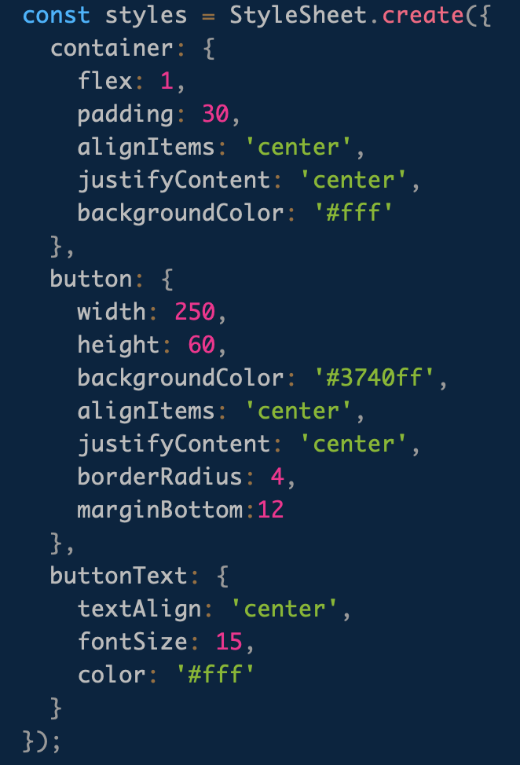
Using React Native Image Picker in React Native App

Slide 32
Using React Native Image Picker in React Native App
In the given above code, we will initiate the Image Picker by clicking on a “Select File” Button. It will display a popup to “Select Image” with the following options.
Take Photo
Choose from Library
Choose a file from Custom Option

Slide 33
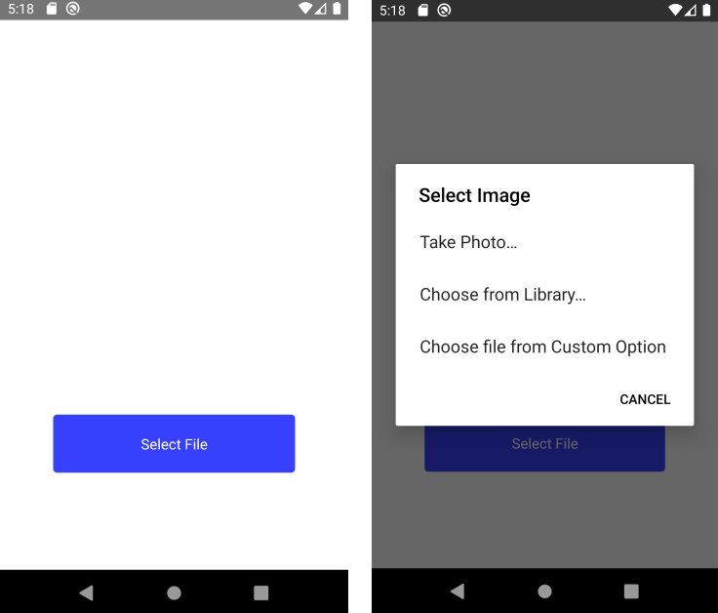
Using React Native Image Picker in React Native App

Slide 34
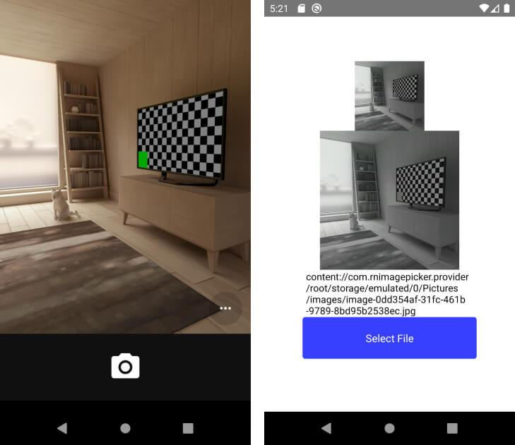
Using React Native Image Picker in React Native App
The example of Image Picking in React Native from Camera

Slide 35
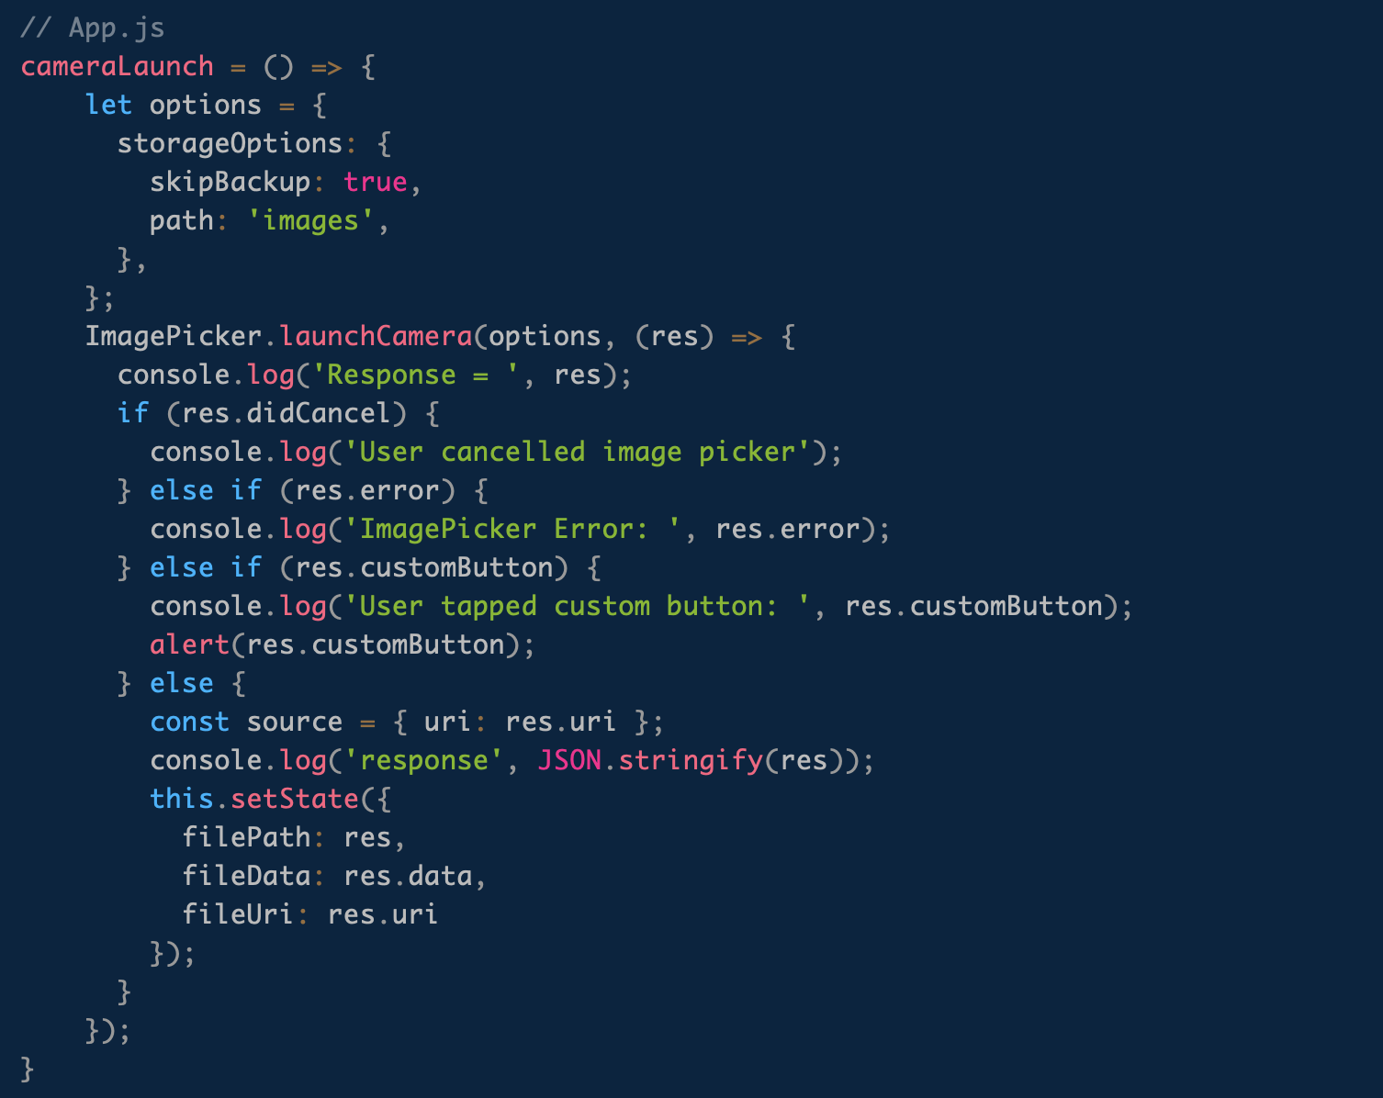
Launch Camera Directly in React Native App

Slide 36
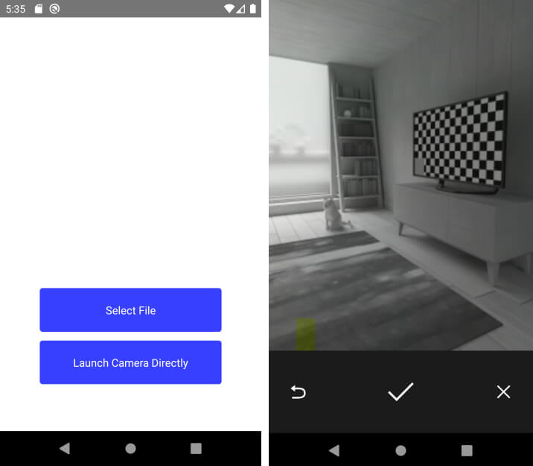
Launch Camera Directly in React Native App

Slide 37
Summary
In this session, we learned the following:
Understand what is the API platform
Understand using Geolocation to build map apps from Google Map
Understand to accessing the user’s image and camera via React Native app

